Slide 1
Structural Design Patterns
Continous staff improvement project
Yurii Hohan

Slide 2
Introduction
Proxy pattern.
Decorator pattern.
Facade pattern.

Slide 3
Structural Patterns
Structural patterns are concerned with how classes and objects are composed to form larger structures.
Structural class patterns use inheritance to compose interfaces or implementations.
Structural object patterns describe ways to compose objects to realize new functionality.
Many structural patterns are related to some degree.

Slide 4
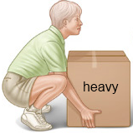

Proxy Pattern. Warm-up
You want to impress your friends by carrying a 100 kg box (what an impression).
It is not easy as you see!
What to do?
Create another box of exactly the same look, but lighter.
Now you can go!
The ‘not that heavy’ box is the proxy of the normal box.
But still makes the same effect ☺

Slide 5


Proxy Pattern. Warm-up
Drawback money from the bank!
We will not go to a bank branch.
Just go to an ATM.
Get the cash!
So ATM is some kind of a bank.
With reduced functionalities.
ATM is also a proxy to the bank!

Slide 6
Intent And motivation
Intent - Provide a surrogate or placeholder for another object to control access to it.
Motivation
Proxy pattern comes into play when we have HeavyWeight objects and
We want to implement a simpler version of a HeavyWeight object.
We don’t need the whole functionality of the HeavyWeight object.
We want to limit the access to the HeavyWeight object.
We want to delay the access to HeavyWeight object. There may be a time-delay or complex mechanism in creating instances of HeavyWeight objects.
Proxy pattern is also known as «surrogate».
Means to put something into place of another

Slide 7
Applicability
A remote proxy provides a local representative for an object in a different address space.
An object from other server
Object from the database server
A virtual proxy creates expensive objects on demand.
Drag and drop object before being dropped can be substituted by a proxy
A protection proxy controls access to the original object.
An object to which different users have different access rights

Slide 8
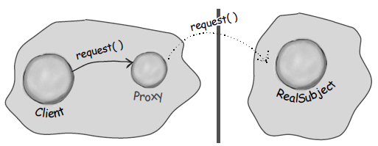
Remote Proxy
Provides a local represent of an object in different address space (or maybe in same address)

Slide 9
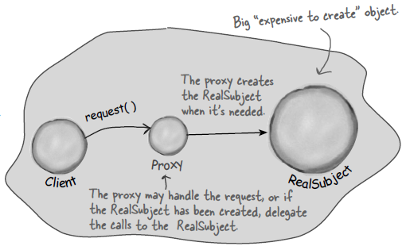
Virtual Proxy
When we have so many heavyweight objects, we can create virtual proxies for objects to load program faster.
Program can start with proxies and real subjects may be downloaded on background (or when requested).

Slide 10
participants
Subject (Bank)
The common interface for the proxy and the real subject
Real Subject (Bank Branch)
The concrete subject that implements the interface.
Proxy (ATM)
Provides the same interface as Real Subject (or a subset)
Maintains a reference to the Real Subject
Since it doesnot have all the data as Real Subject (a lightweight), it can do many things faster than Real Subject.
Then invokes Real Subject (if needed).

Slide 11
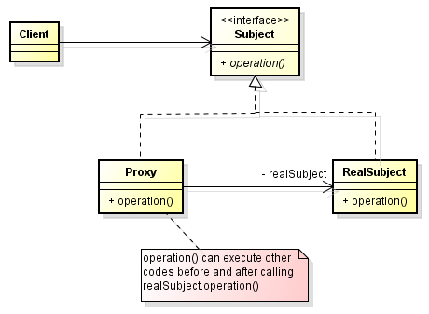
Proxy Pattern Structure

Slide 12
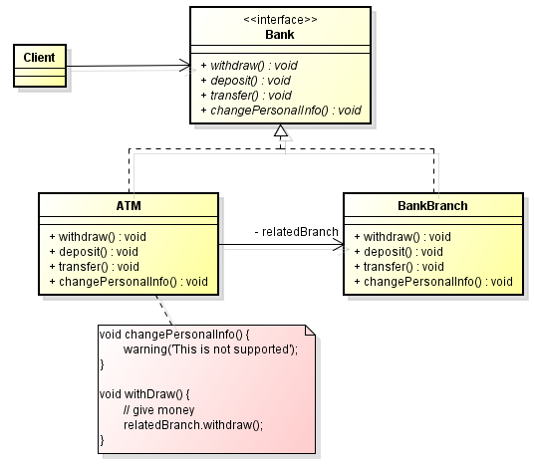
Concrete Structure

Slide 13
Consequences
A level of indirection while accessing real subject.
We can think this as another tier between real subject and us.
We want to support heavyweight objects, but we want to create only when they are requested.
Memory will not get full.
Programs will run faster.
It is like giving a small example of the same subject.
Most of the times, proxy will have same interfaces as subject.
Programmers can declare variables without caring whether a proxy or the heavyweight will be put.

Slide 14
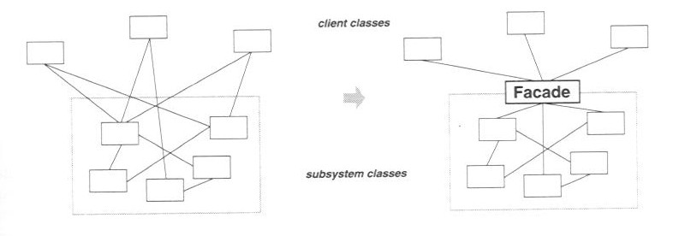
Façade pattern.

Slide 15
Façade pattern.
Introduce a Façade object that provides a simplified interface to the subsystem
The Façade's interface provides exactly those operations needed by most clients, and no more
The Façade translates high-level client requests into lower-level requests on subsystem objects
Internal subsystem objects have no knowledge of the Façade

Slide 16
Façade pattern. Structure
Most clients interact with the subsystem strictly through the Façade
Advanced clients may still be allowed to access the full scope of subsystem functionality, but most clients don't need or want to
Similar to keeping a class' implementation details private, and making public only those operations directly needed by clients (i.e., information hiding)

Slide 17
Façade pattern. Consequences
Makes using the subsystem easier
Reduces coupling between clients and the subsystem
Reduces compilation dependencies, thus minimizing recompilation time
Useful for defining the interfaces between layers in a layered system

Slide 18
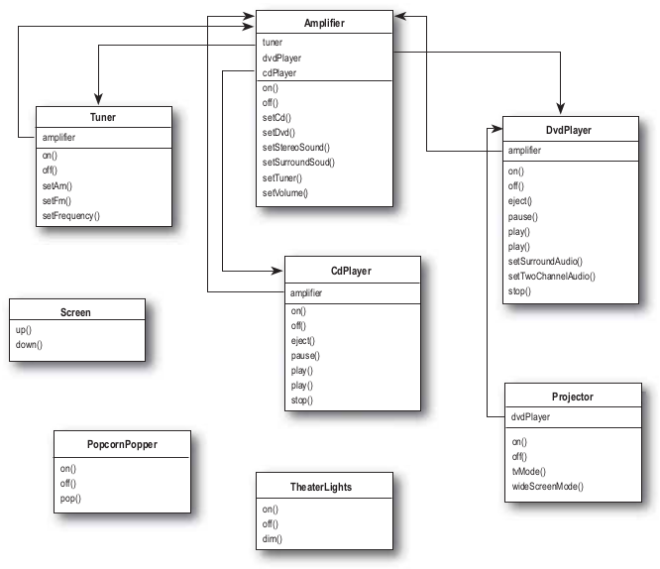
Example: HOME Theater Facade

Slide 19
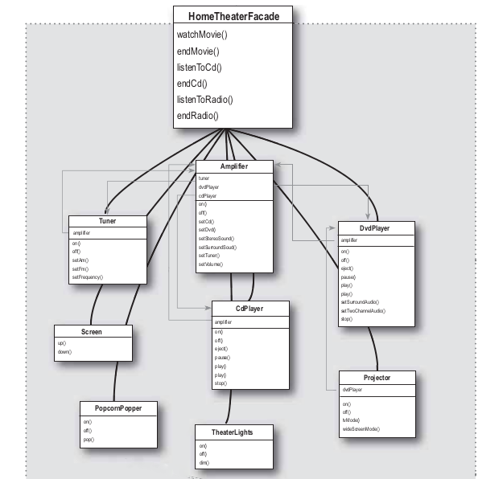
Example: HOME Theater Facade

Slide 20
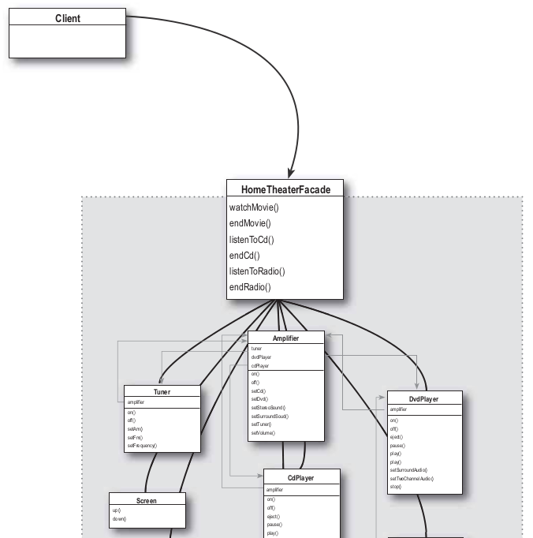
Example: HOME Theater Facade

Slide 21
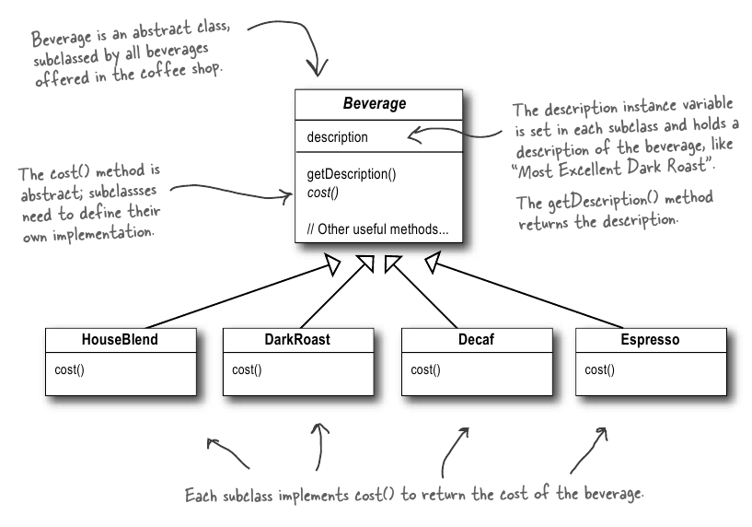
Decorator. Warm Up.

Slide 22
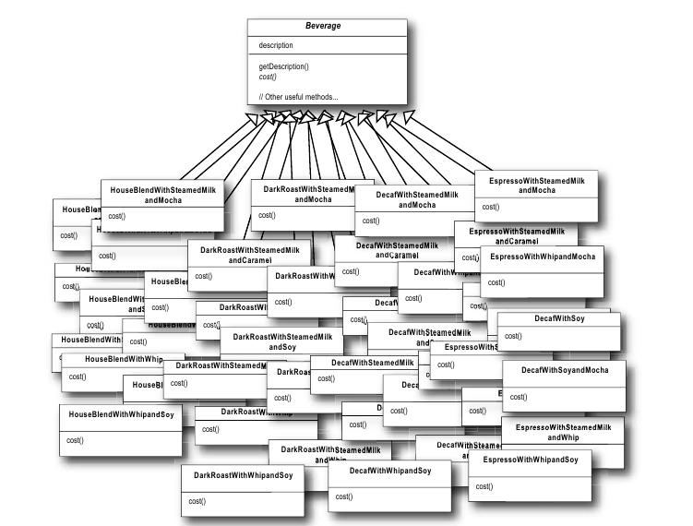
Decorator. Warm Up.

Slide 23
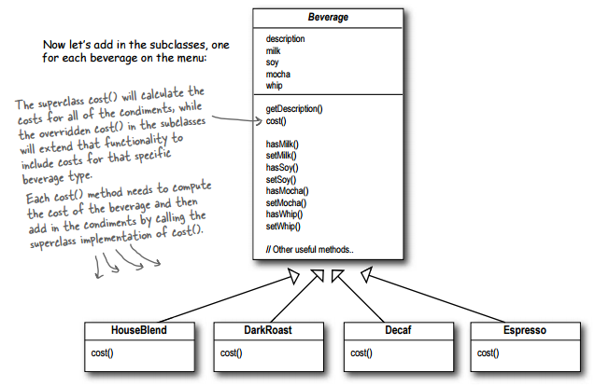
Decorator. Warm Up.

Slide 24
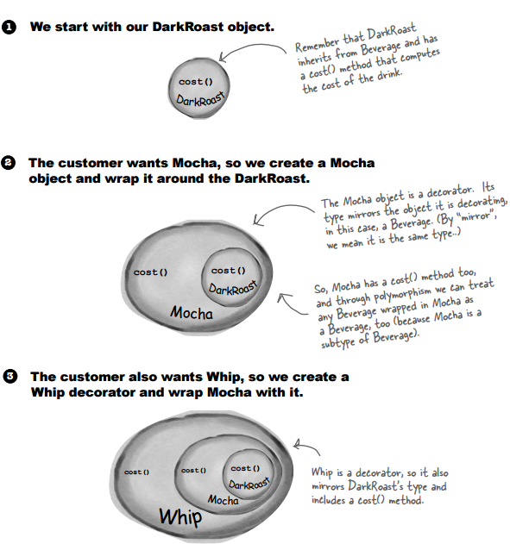
Constructing Drink order

Slide 25
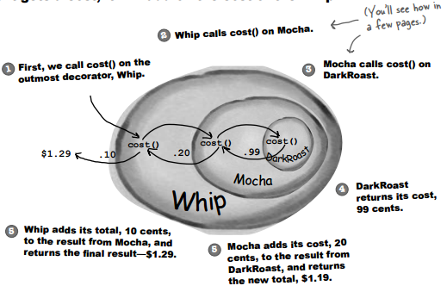
Compute cost

Slide 26
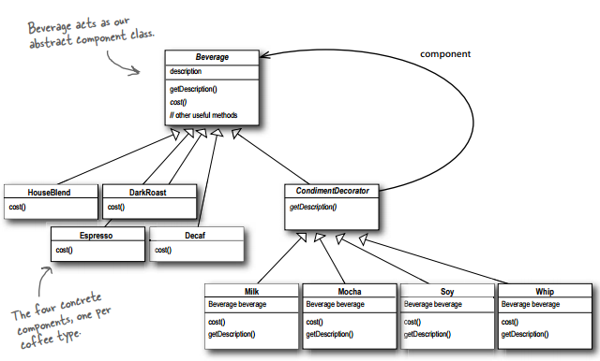
Decorator

Slide 27
Decorator. Intent
Intent - Attach additional responsibilities to an object dynamically. Decorators provide a flexible alternative to subclassing for extending functionality.

Slide 28
Decorator. Motivation
Sometimes we want to add responsibilities to individual objects, not to an entire class.
Inheritance is inflexible because the responsibilities statically.
A more flexible approach is to enclose the component in another object that adds the responsibilities.
The enclosing object is called Decorator.

Slide 29
Decorator. Motivation(2)
The decorator conforms to the interface of the component it decorates so that its presence is transparent to the clients.
The decorator forwards requests to the component and may perform additional actions before and/or after forwarding.
Transparency lets you nest decorators recursively.

Slide 30
Applicability
Use Decorator
to add responsibilities to individual objects dynamically and transparently.
for responsibilities that can be withdrawn.
When extension by subclassing is impractical.

Slide 31
Participants
Component
defines the interface for objects that can have responsibilities added to them dynamically.
Concrete Component
defines an object to which additional responsibilities can be attached.
Decorator
maintains a reference to a Component object and defines an interface that conforms to Component’s interface.
Concrete Decorator
adds responsibilities to the component.

Slide 32
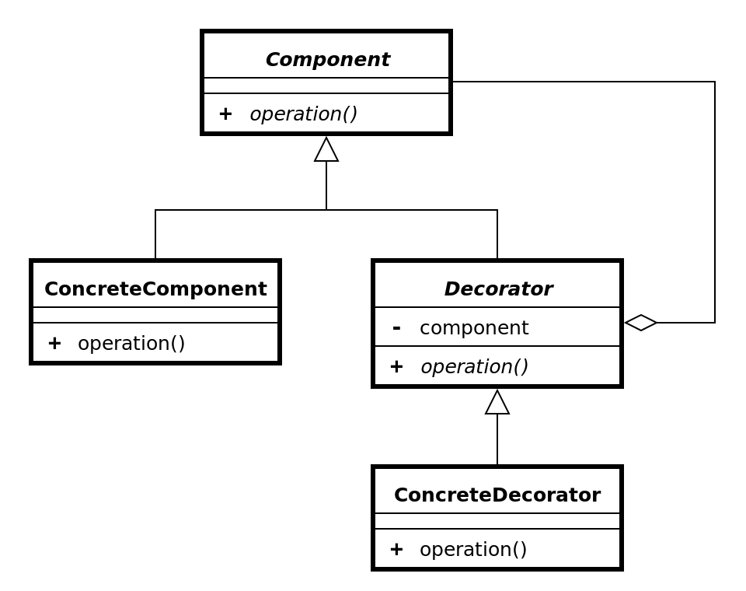
Decorator Pattern. Structure

Slide 33
Consequences(1)
More flexibility than static inheritance.
responsibilities can be added and removed at run-time simply by attaching and detaching them.
Furthermore, providing different Decorator classes for a specific Component class lets you mix and match responsibilities.

Slide 34
Consequences(2)
Avoids feature-laden classes high up in the hierarchy.
Offers a pay-as-you-go approach to adding responsibilities.
You can define a simple class and add functionality incrementally with Decorator objects.
Also easy to define new kinds of Decorators independently.

Slide 35
Consequences(3)
Lots of little objects
Often results in systems composed of lots of little objects that all look alike. The objects differ only in the way they are interconnected, not in their class or in the value of their variables.
Although these systems are easy to customize by those who understand them, they can be hard to learn and debug.

Slide 36
Revisions
Number | Author | Date | Description
1.0.0 | Yurii Hohan | 07.12.2015 | Initial version
1.1.0 | Lucash Oleg | 21.07.2017 | Changed decorator example.

Slide 37
Assignment
Introduce a Proxy in your project
Introduce a decorator in Your Project
Create example of facade
Law of Demeter

